Slide 1
COVID-19 Update
Meg Fisher, MD
September 21, 2021

Slide 2
Disclaimer
Information about COVID-19 and SARS-CoV-2, the virus that causes the illness is evolving daily
Recommendations change frequently
What you hear today may be outdated soon
Trusted sources of up-to-date information
NJ Department of Health - www.nj.gov/health/
Centers for Disease Control and Prevention - www.cdc.gov
American Academy of Pediatrics – www.aap.org and www.healthychildren.org

Slide 3
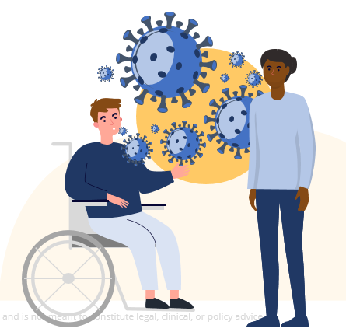
COVID-19
Disease caused by SARS-CoV-2
Spread primarily by droplets
Most droplets fall to the ground within 3 to 6 feet
https://www.cdc.gov/coronavirus/2019cov/transmission/index.html

Slide 4
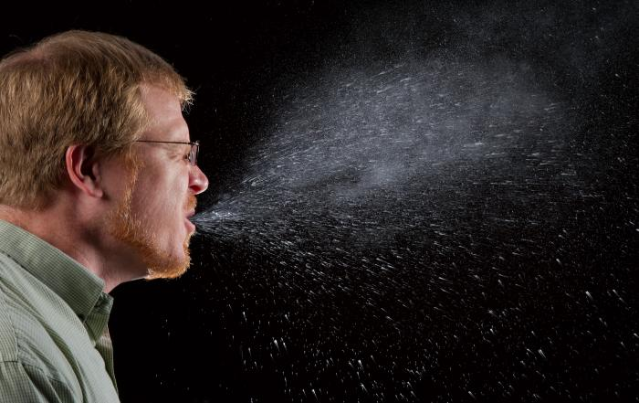
Transmission

Slide 5
How to help prevent the spread
Wear a mask that covers your nose and mouth
Stay at least 6 feet (about 2 arms lengths) from others
Avoid crowds and sick people
Wash your hands often
Get vaccinated
https://www.cdc.gov/coronavirus/2019-ncov/your-health/need-to-know.html

Slide 6
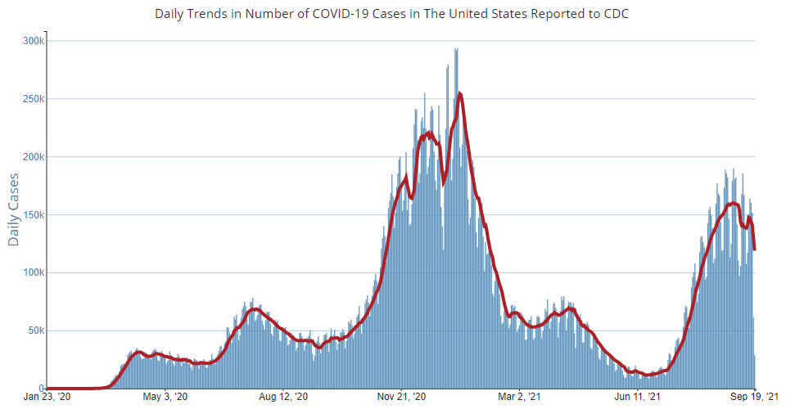
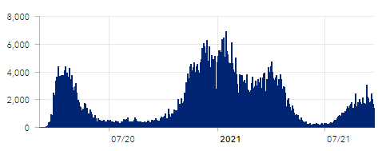
COVID-19 Cases in the US and in NJ
September 19, 2021
https://covid.cdc.gov/covid-data-tracker/#trends_dailycases
September 21, 2021
https://www.nj.gov/health/cd/topics/covid2019_dashboard.shtml

Slide 7
COVID-19 Basics
Disease varies from asymptomatic to mild upper respiratory illness to pneumonia to multiorgan involvement and death – to date 672,738 deaths in US, 24,429 in NJ
Disease in children usually either asymptomatic or mild but not always, 460 deaths in US, 7 in NJ
Multisystem inflammatory syndrome – Children (MIS-C) is a rare post-infectious complication – as of August 27 - 4661 cases, 41 deaths; as of September 20,133 in NJ, 0 deaths
https://covid.cdc.gov/covid-data-tracker/#mis-national-surveillance

Slide 8
Post-COVID Conditions
Long COVID, long-haul COVID, post-acute COVID
Multiorgan system effects, autoimmunity
Post-ICU syndrome: weak, brain fog, PTSD
Breathing difficulty | Tired or fatigued | Worse after activity
“Brain fog” | Cough | Pain: chest or stomach
Headache | Palpitations | Joint or muscle pain
Pins-and-needles feeling | Diarrhea | Sleep problems
Fever | Dizzy on standing | Rash
Mood changes | Smell/taste changes | Menstrual changes
https://www.cdc.gov/coronavirus/2019-ncov/long-term-effects.html

Slide 9
covid19.nj.gov/vaccine
COVID-19 vaccines are
You can get a vaccine if you are uninsured, and / or undocumented
SAFE
EFFECTIVE
FREE for all
Confidential, preliminary, pre-decisional, and deliberative. Content is descriptive only and is not meant to constitute legal, clinical, or policy advice.
Notes:
As a reminder, COVID-19 vaccines are safe, effective, and free for all. You do not need proof of immigration, documentation, or insurance to get the vaccine.

Slide 10
COVID-19 Vaccines
Messenger RNA (mRNA) vaccines
Pfizer – EUA 12/11/20 – for ages 16 years and older; EUA 5/10/21for ages12 to 17; Licensed 8/23/21 for ages 16 and older (Comirnaty)
Moderna – EUA 12/18/20 – for ages 18 years and older
Adenovirus vector
J&J Janssen – EUA 2/27/21 – for ages 18 years and older
AstraZeneca – not available in US
https://www.cdc.gov/coronavirus/2019-ncov/vaccines/different-vaccines/how-they-work.html

Slide 11
About mRNA COVID-19 Vaccines
Messenger RNA codes for the spike protein of the virus
Carrier is a lipid nanoparticle
Lipid allows the mRNA to enter cells
Code is read and spike protein produced
Immune system responds with antibodies and cell mediated immunity
Two dose series, maybe boosters
https://www.cdc.gov/coronavirus/2019-ncov/vaccines/different-vaccines/mRNA.html

Slide 12
J&J Janssen COVID-19 Vaccine
Code for the spike protein inserted into an altered human adenovirus (Ad26.COV2.S)
Replication incompetent virus
Adenovirus enters cells and releases code for the spike protein
Immune systems responds to the spike protein
Given as a single dose, maybe booster
https://www.cdc.gov/coronavirus/2019-ncov/vaccines/different-vaccines/viralvector.html

Slide 13
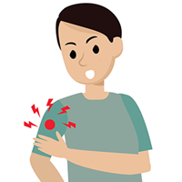
Side Effects of mRNA COVID-19 Vaccines
Most common complaint was pain at the injection site
Other common symptoms included fatigue, fever, and headache
These are common side effects after getting vaccinated
Risk for severe reaction to the vaccine about 0.5%
People with a history of severe allergies (anaphylaxis) to food or medicine should talk to their doctor before taking the vaccine
Side effects less common in people over 50 years of age
Side effects more common after the second dose

Slide 14
Anaphylaxis and mRNA COVID-19 Vaccines
Pfizer-BioNTech
21 cases after 1,893,360 first doses (11.1 cases per million doses)
71% within 15 minutes of vaccination; 86% within 30 minutes
90% of cases in women; 81% of cases had a history of allergic reactions
Moderna
10 cases of anaphylaxis after administration of a reported 4,041,396 first doses (2.5 cases per million doses administered)
90% within 15 minutes of vaccination
100% women; 90% history of allergic reactions

Slide 15
Recommendations
Ensure supplies available to manage anaphylaxis, especially epinephrine in prefilled syringes or autoinjectors
Screen potential vaccine recipients to identify persons with contraindications and precautions
Observation periods, 15 or 30 minutes depending on history
Recognize the signs and symptoms of anaphylaxis early
Treat suspected anaphylaxis with intramuscular epinephrine immediately
Instructed people to seek immediate medical care if they develop signs or symptoms of an allergic reaction after they leave
Report adverse events vaers.hhs.gov/reportevent.htmlexternal icon.
https://www.cdc.gov/mmwr/volumes/70/wr/mm7002e1.htm; https://www.cdc.gov/mmwr/volumes/70/wr/mm7004e1.htm

Slide 16
Myocarditis and Pericarditis
Increased reports since April 2021
Following mRNA vaccines
Most in adolescents and young adults
More common following second dose
Most patients responded well to medications and recovered quickly
CDC continues to recommend vaccination for everyone 12 years and older
Monitoring continues
https://www.cdc.gov/coronavirus/2019-ncov/vaccines/safety/myocarditis.html

Slide 17
Side Effects of the Adenovirus Vector COVID-19 vaccines
Most common complaint was pain at the injection site
Other common symptoms included fatigue, fever, and headache
These are common side effects after getting vaccinated
Side effects less common in people over 60 years of age
Single dose

Slide 18
Serious Side Effects
Thrombocytopenia and Thrombosis with J&J vaccine
Cerebral venous sinus thrombosis and other thromboses
Single case during studies: 25-year-old male
Six additional cases: women 18 to 48 years old, one fatal
Onset within 6 to 13 days of vaccination
PF4 HIT (Platelet Factor 4 Heparin Induced Thrombocytopenia) antibody positive

Slide 19
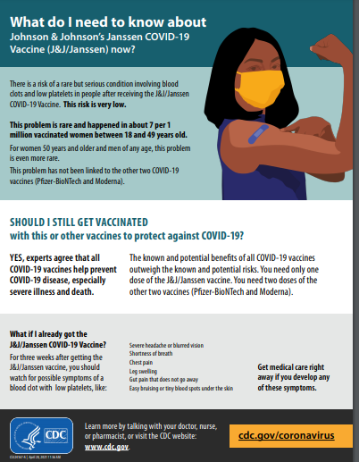
US FDA and CDC Recommendations
Pause on use of J & J vaccine 4/13/21; reassessed; use resumed 4/23/21
Vaccinees - seek medical treatment urgently for any of the following:
Severe headache or blurred vision
Shortness of breath
Chest pain
Leg swelling
Gut pain that does not go away
Easy bruising or tiny blood spots under the skin
Healthcare providers – maintain awareness
Report adverse events vaers.hhs.gov/reportevent.htmlexternal icon.
https://www.cdc.gov/coronavirus/2019-ncov/vaccines/safety/JJUpdate.html

Slide 20
Guillain-Barré Syndrome
Ascending paralysis
Usually self-limited with full recovery
Incidence slightly more common after J&J vaccine than baseline
100 cases reported after 13 million doses
Baseline is 3000 to 6000 cases per year
Onset about 2 weeks after immunization
FDA added warning to J&J EUA fact sheet on 7/12/21
https://www.fda.gov/media/146304/download

Slide 21
Fertility
No evidence of any effect of these COVID-19 vaccines on either male or female fertility
No biologic reason to expect it
No clinical evidence
ACOG recommends vaccine for all eligible people who may consider future pregnancy, as well as all pregnant and breastfeeding women
https://www.cdc.gov/coronavirus/2019-ncov/vaccines/facts.html
https://www.acog.org/clinical/clinical-guidance/practice-advisory/articles/2020/12/covid-19-vaccination-considerations-for-obstetric-gynecologic-care

Slide 22
COVID-19 Variants
Arise as viruses multiply
Variants of interest – changes in binding protein, therapy, possible increased illness and transmission
Many: arising in US and globally
Variants of concern – increased transmission and illness, decreased susceptibility to antibodies and therapy
B1.1.7 alpha UK; B1.351 beta So Africa; B1.617.2 delta India; P1 gamma Japan/Brazil
Variants of high consequence – reduced susceptibility to preventive measures and countermeasures
None yet
https://www.cdc.gov/coronavirus/2019-ncov/variants/variant.html

Slide 23
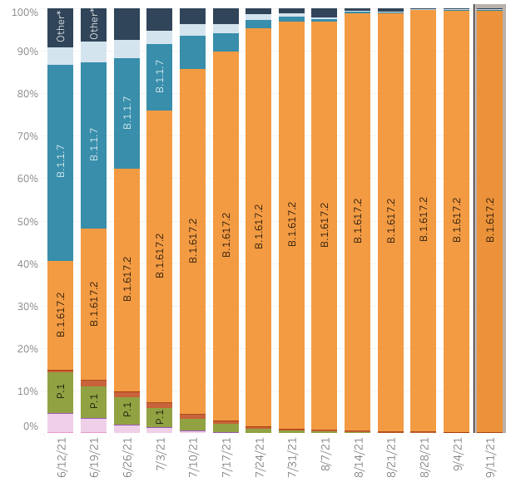
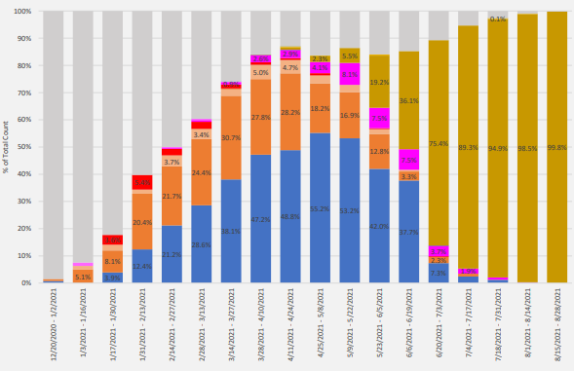
COVID-19 Variants
New Jersey – December to August
Alpha
UK
Delta
India
Alpha
UK
Delta
India
https://www.nj.gov/health/cd/documents/topics/NCOV/COVID_19_Variant_Report_Week_2021_34.pdf

Slide 24
NJ COVID Vaccine Call Center
You can make an appointment for the COVID-19 vaccine, get help with the scheduling system, check registration status, and ask vaccine questions by phone
Interpreters are available
Hola
नमस्कार
안녕하세요
નમસ્તે
مرحبا
您好
Bonjour
Olá
Call 855-568-0545
Confidential, preliminary, pre-decisional, and deliberative. Content is descriptive only and is not meant to constitute legal, clinical, or policy advice.

Slide 25
covid19.nj.gov/vaccine
Confidential, preliminary, pre-decisional, and deliberative. Content is descriptive only and is not meant to constitute legal, clinical, or policy advice.
Notes:
Once you are on covid19.nj.gov, you can click one of the icons to
Find out if you are eligible
Register with the state scheduling portal (more information on this to follow)
Book an appointment directly with a vaccine location

Slide 26
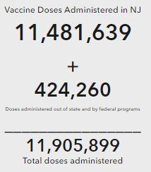
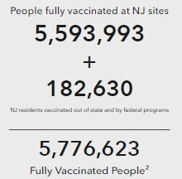
Vaccination Rates in New Jersey
https://www.nj.gov/health/cd/topics/covid2019_dashboard.shtml

Slide 27
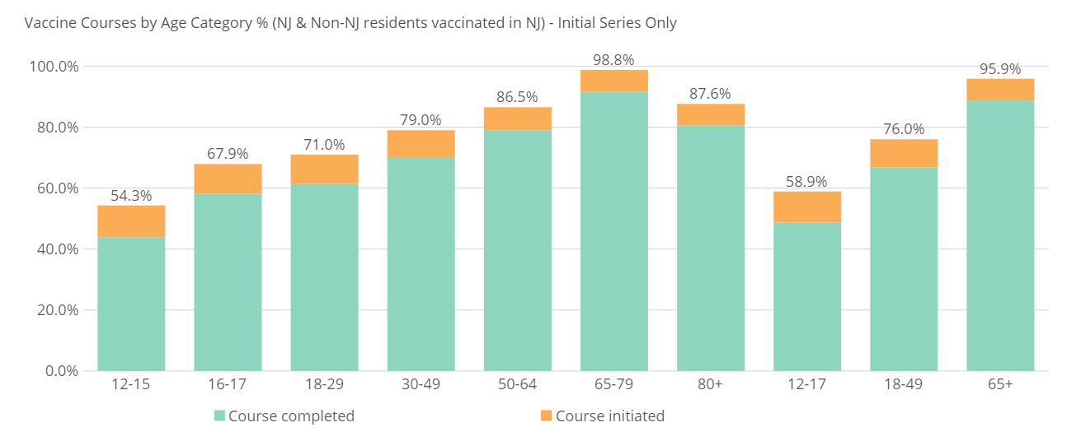
Daily report on vaccination (as of 10pm 09/19/2021)
Initial vaccine courses by age category, % of total population
Additional vaccine dose by age category, % of completed initial course^{1,2}
0.1%
0.1%
0.2%
0.4%
1.0%
3.0%
3.0%
0.1%
0.3%
2.9%
1. Additional/3rd doses administered –starting Aug-13
2. The data may increase as more sites report. Note, the data was collected at 8AM on September 20th and it is likely to be undercounting as electronic transmissions may occur during the late evening/early morning the next day
Note: Includes all individuals who were vaccinated within New Jersey (those who live work or study within New Jersey). Excludes vaccines administered through select federal programs (e.g., Bureau of Prisons, Veterans Health, Indian Health Service, and Department of Defense) as well as NJ residents vaccinated in other states
Source: NJIIS, Vtrcks

Slide 28
Natural Versus Vaccine Immunity
More unknowns than known
Natural immunity seems solid for at least 3 months
Vaccine immunity seems even better
Trials with all 3 vaccines show protection at least 9 months
Immunity against the known variants is solid
Trials are underway to see if one dose is enough to boost natural immunity
https://www.cdc.gov/vaccines/covid-19/hcp/answering-questions.html

Slide 29
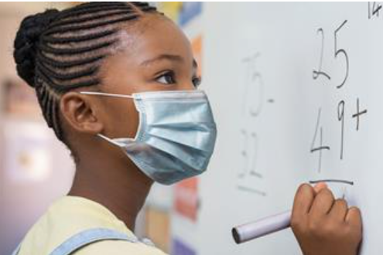
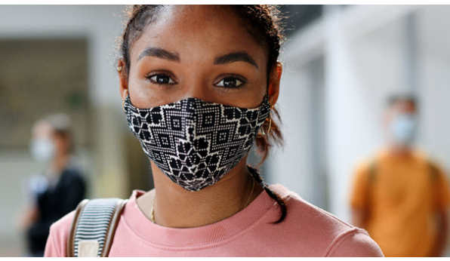
Safety at School
Masks for everyone while inside
Maintain 3 foot distance
Vaccines for all eligible people
Cohort younger children
Contact tracing
Isolation for infected people
Quarantine for unvaccinated close contacts
https://www.cdc.gov/coronavirus/2019-ncov/community/schools-childcare/k-12-guidance.html https://www.aap.org/en/pages/2019-novel-coronavirus-covid-19-infections/clinical-guidance/covid-19-planning-
considerations-return-to-in-person-education-in-schools/

Slide 30
Help us spread the word!
The COVID-19 vaccine is safe, effective, and free for all
@NJDeptofHealth
#VaccinesWork
#LetsGetNJVaccinated

Slide 31
Thank you

